Slide 1

By
AKHIL ANILKUMAR

Slide 2
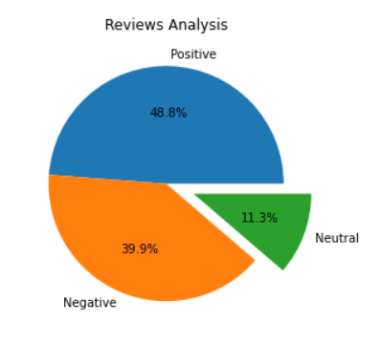

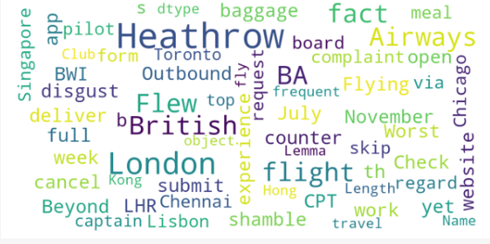
INSIGHTS FROM CUSTOMER REVIEWS
From cleaning 1000 reviews given by the customers, we obtained
Word cloud of keywords used in reviews

